Slide 1
Road Transport Module
Glow Institute of Professional
studies

Slide 2
INTRODUCTION
In the present scenario logistics is playing crucial roll in all the major business. It is very expensive to have own logistics within the organisation. So all of the business are depends on the third party logistics. Out of the logistics business, Road trasport is one of the major and mostly used one.
The Road transport logistics business vendors, they are very hard to make complete track on transport charges paid with transport charges collected. In the mean time they have to maintain register for own trucks and drivers and also want track the cost of each Revenue transaction wise.
For them we are providing solution through Tally with our customised module to maintain the records of all day to day business activies who are the vendors and thier vehicle. Also to find the net revinue of each transaction.
We hope this module will satisfy all of your needs.

Slide 3
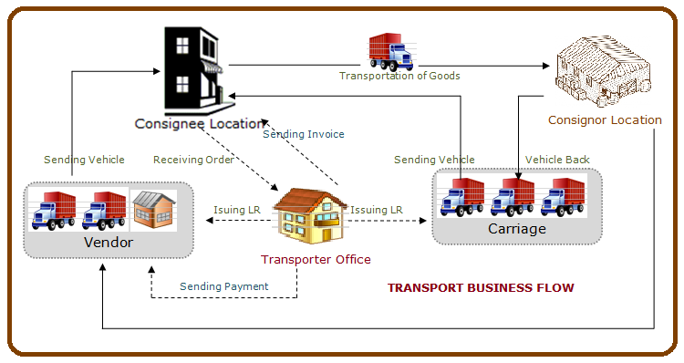
BUSINESS PROCESS

Slide 4
TRANSPORT MODULE OVERVIEW
Enable this module in F11 Features
Fixing prices for Vendor and Customer
Creation of Masters like Transporter, Truck, Driver, Destination and Consignee
Raising Lorry reciept from Tally. And payment of advance while generating Lorry Receipt. Printing LR from Tally.
Raising bills against LR (Tracking of LR in Invoice)

Slide 5
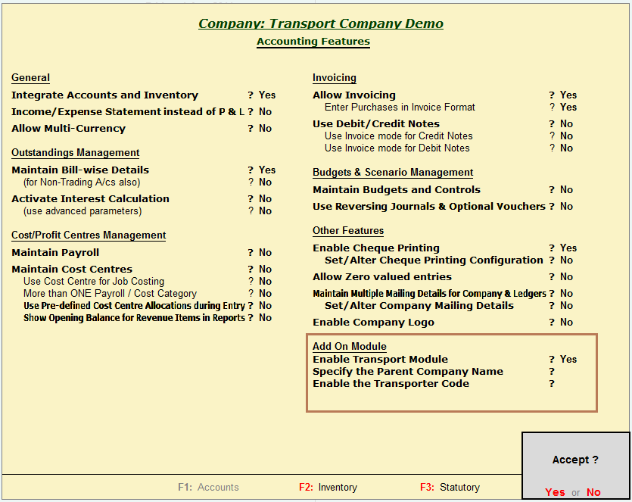
ENABLING TRANSPORTER MODULE
F11 Feature -> Accounting Features

Slide 6
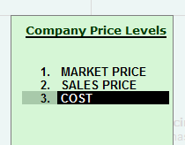
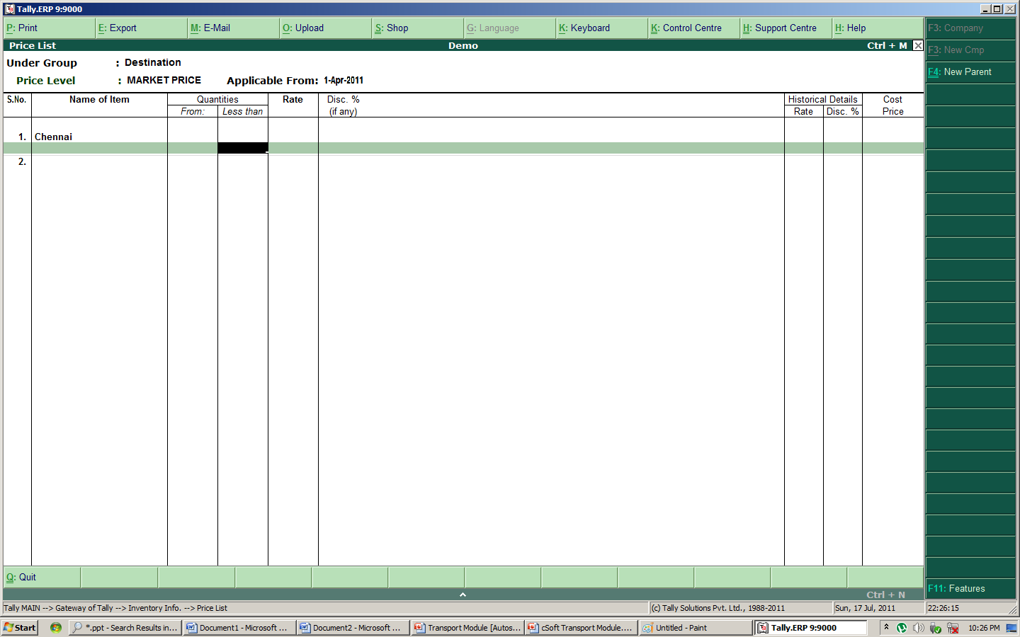
ENABLING & FIXING PRICE LIST
To enable price list: F11 Feature -> Inventory Features
To fix the price: Gateway of Tally -> Inventory Info -> Price List

Slide 7
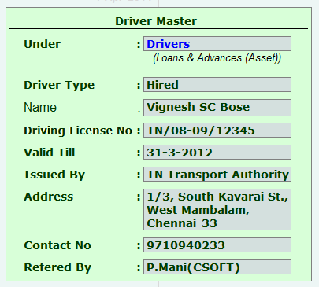
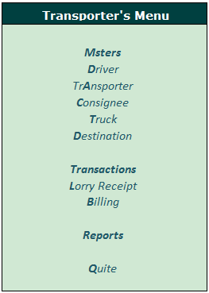
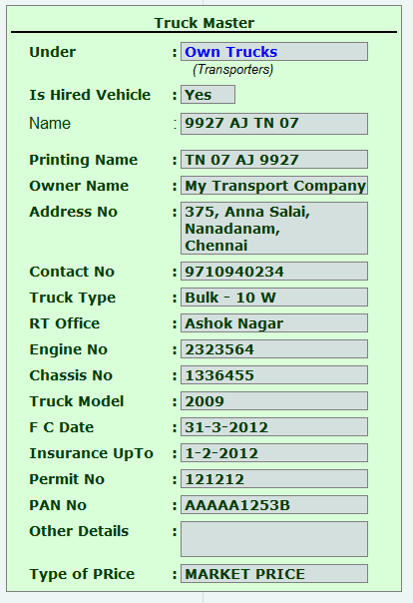
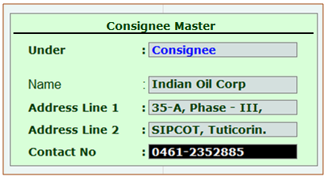
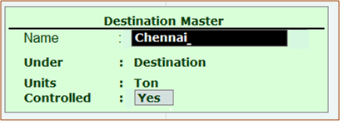
TRANSPORTER’S MENU - MASTERS

Slide 8
DRIVER MASTER CREATION
Financial Allocation of Driver Master
Is he hired driver
for Controlling
Name of the Driver
Driving License Number of the Driver
Expiry date of
the DL No
Issued Authority
of the DL
Communication Address of the Driver
Contact Number of the Driver
The person who referred the Driver
Notes:
In Driver Master we are capturing all required records of the driver.

Slide 9
TRANSPORTER MASTER CREATION
To map the Trucks with Trasporters
Notes:
To find the consolidated business for each transpoter Truck wise

Slide 10
CONSIGNEE MASTER CREATION
For Ledger Allocation Purpose
Consignee Name
Consignee Address
Consignee Contact No

Slide 11
TRUCK MASTER CREATION
Financial Allocation of Truck Master
Control Field
Truck Identification Name
Name for Printing in Lorry Receipt
Owner Related Details
( Name, Address & Contact No)
Truck Registration Records, Full Condition and Insurance Details
Other Records
(PAN and Any ref.)
Price list Marking
All the details are captured to ensure the undisturbed transit and to track the vehicle
Notes:
All the details are captured to ensure the secure and undisturbed transit

Slide 12
DESTINATION MASTER CREATION
Financial Allocation of Truck Master
Units of Measurement
Control Field

Slide 13
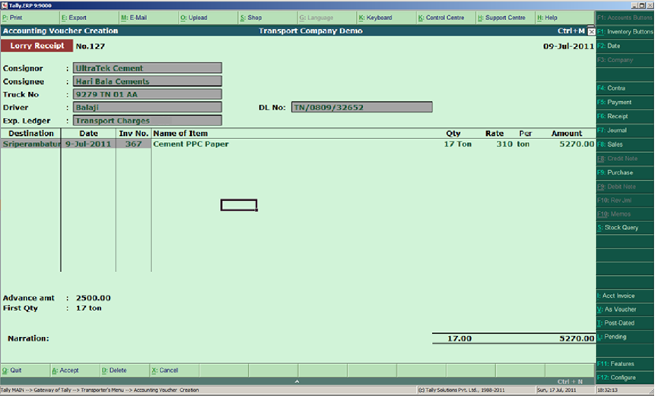
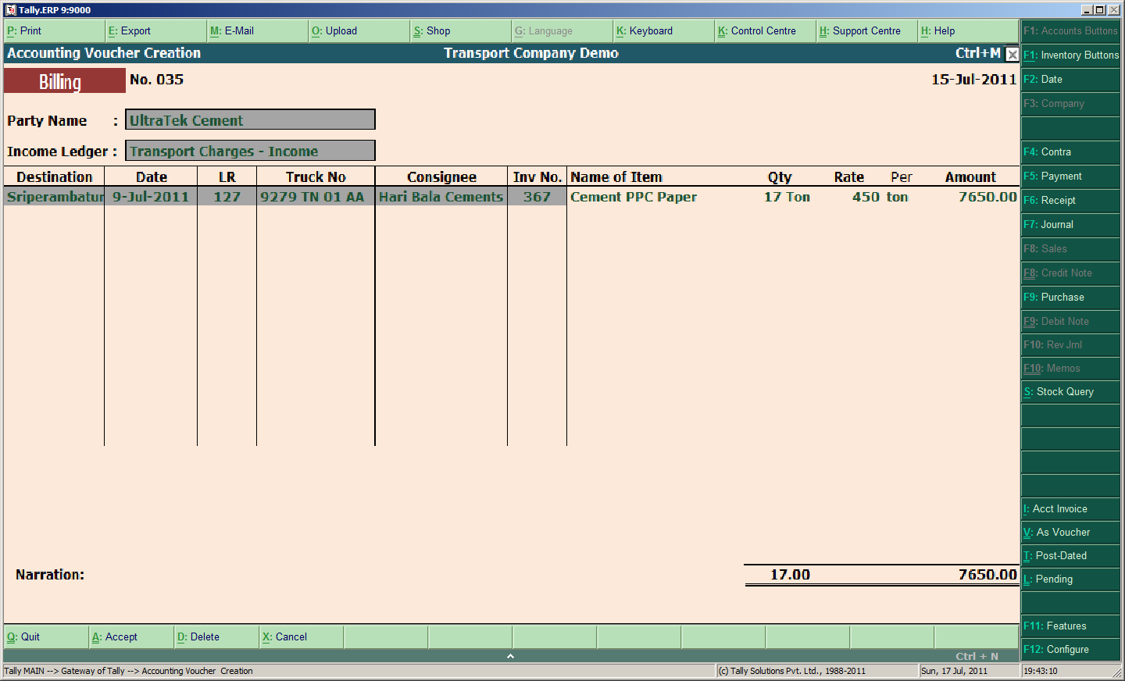
TRANSACTIONS

Slide 14
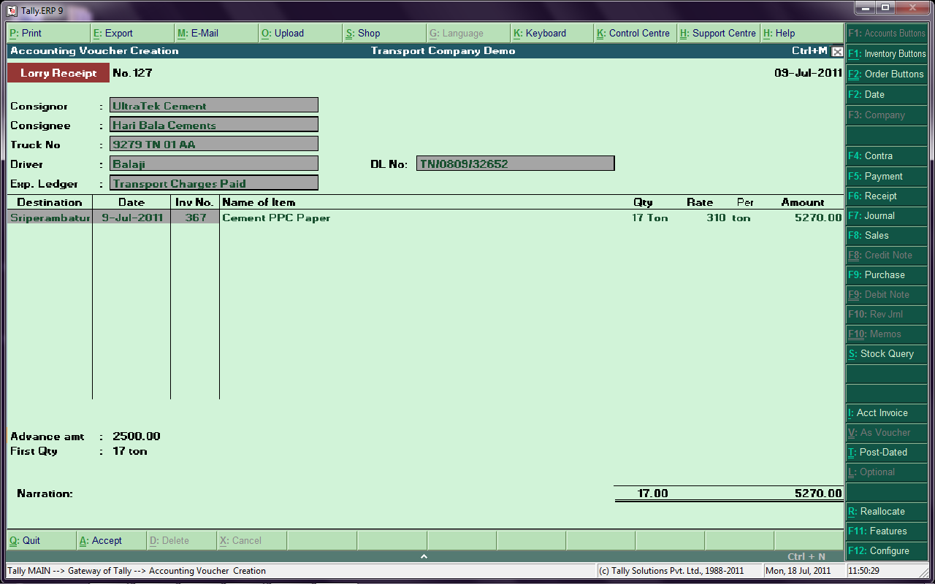
LORRY RECEIPT - ENTRY
Financial Entry1:
Dr. Trasport Charges 5270.00
Cr. 9279 TN 01 AA 5270.00
Financial Entry2:
Dr. 9279 TN 01 AA 2500.00
Cr. Advance 2500.00

Slide 15
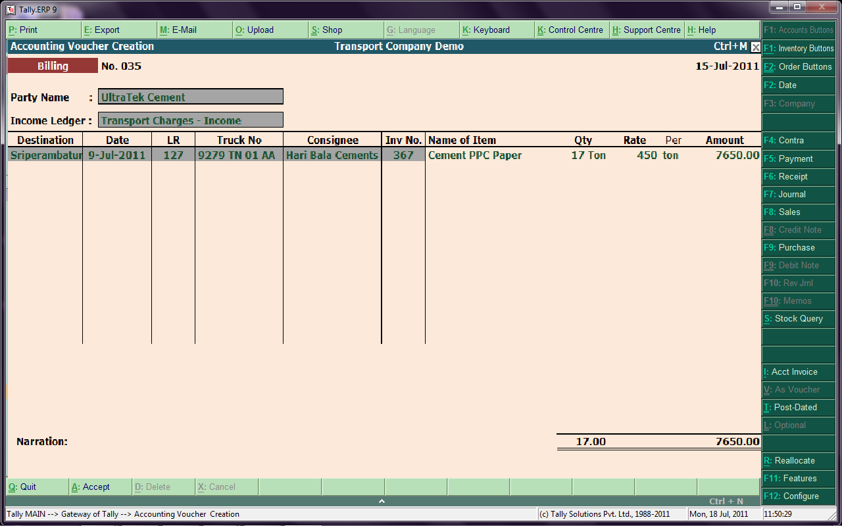
SALES INVOICE
Financial Entry:
Dr. UltraTek Cement 7650.00
Cr. Transport Charges-Income 5270.00

Slide 16
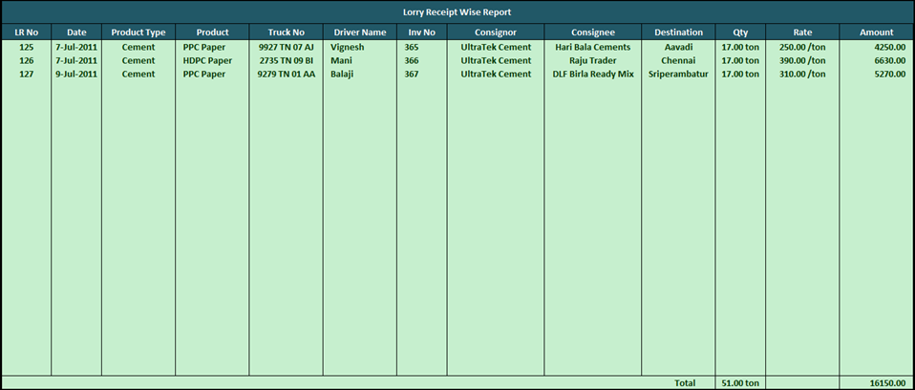
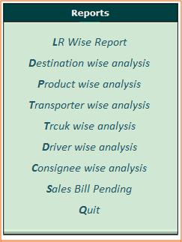
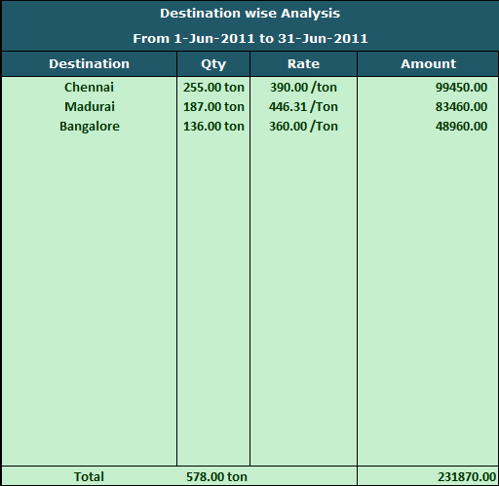
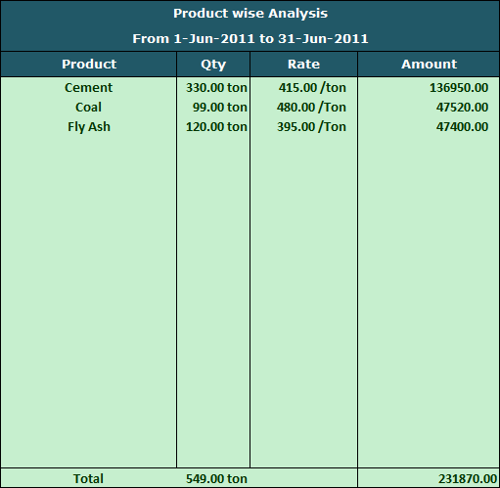
REPORTS MENU part -1

Slide 17
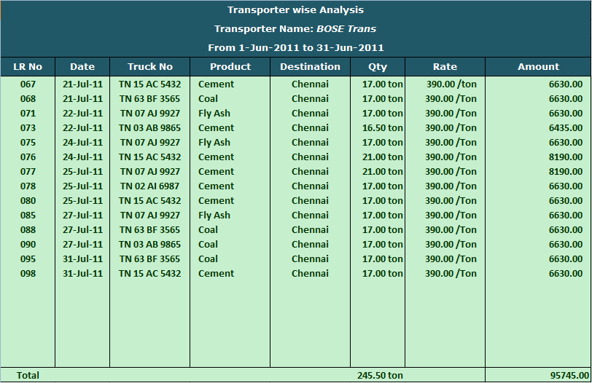
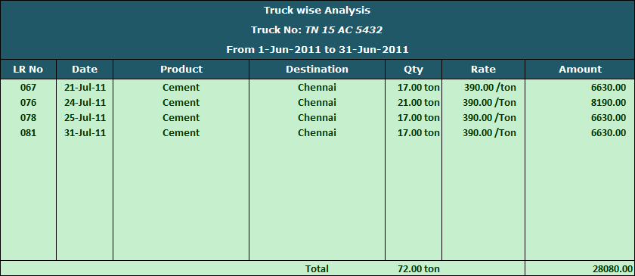
REPORTS MENU part - 2

Slide 18
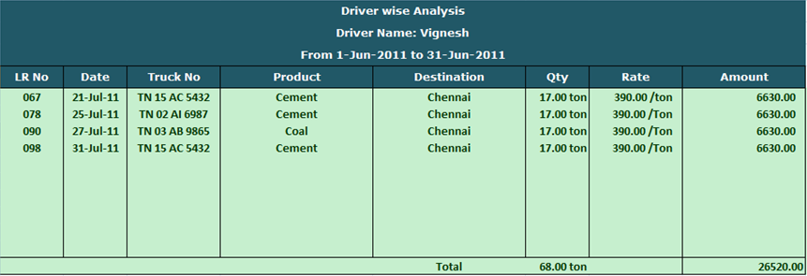
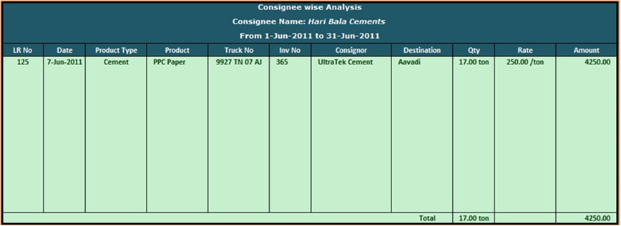
REPORTS MENU part - 3

Slide 19
LORRY RECEIPT WISE REPORT

Slide 20
DESTINATION WISE ANALYSIS

Slide 21
PRODUCT WISE ANALYSIS

Slide 22
TRANSPORTER WISE ANALYSIS

Slide 23
TRUCK WISE ANALYSIS

Slide 24
DRIVER WISE ANALYSIS

Slide 25
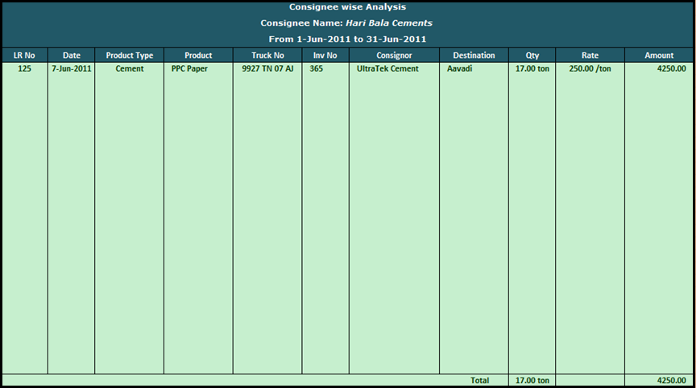
CONSIGNEE WISE ANALYSIS

Slide 26
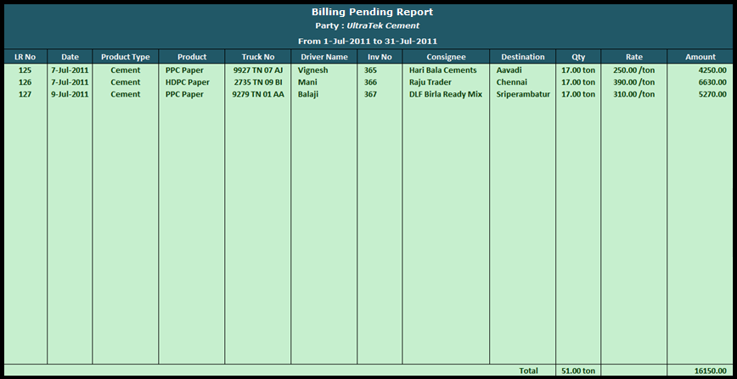
SALES BILL PENDING REPORT

Slide 27
ADDITONAL ADD ONS
Secutiry Module is in built
Auto Manual Voucher Numbering is in built
One Invoice Printing customisation is Free
Lorry Receipt Printing Customisation is Free

Slide 28
Thanks & welcome!
Contact
Glow Ips,
www. Glowips.in
Ph: 0120-2624149
Business Head:
Mr. G K Sharma – 9818569830

